Slide 1
Healthcare Funding Efficiency Analysis
🏥
Understanding how funding aligns with mortality across disease areas
Bhagyalaxmi Nair
📊

Slide 2

Problem Statement
📋
Healthcare funding is not always aligned with disease impact
Limited healthcare resources require efficient allocation
Some high-mortality diseases may be underfunded
Other low-impact areas may receive disproportionate funding
Lack of data-driven insights leads to inefficiencies in decision-making
There is a need to evaluate how effectively funding aligns with mortality
📑

Slide 3

Objective
🎯
This analysis is designed to:
Evaluate the alignment between healthcare funding and disease mortality (Are high-impact diseases receiving adequate funding?)
Develop a key performance indicator (KPI) → Funding per Death to measure efficiency
Identify allocation gaps → Detect overfunded vs underfunded diseases
Enable data-driven decision making → Provide insights to optimize resource allocation
Key Question
“Is healthcare funding proportionate to disease impact?”

Slide 4

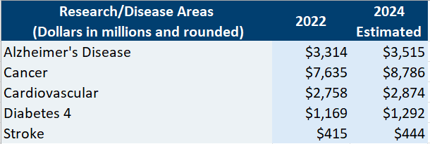

Dataset Overview
📂
The dataset used in this analysis includes:
Disease / Research Area → Represents different healthcare focus areas
Funding Amount ($) → Total funding allocated per disease
Mortality (2019) → Number of deaths associated with each disease
Year → Enables trend analysis over time
Dataset Scope
Covers multiple disease categories
Includes year-wise data for trend analysis
Enables comparison of funding vs impact

Slide 5

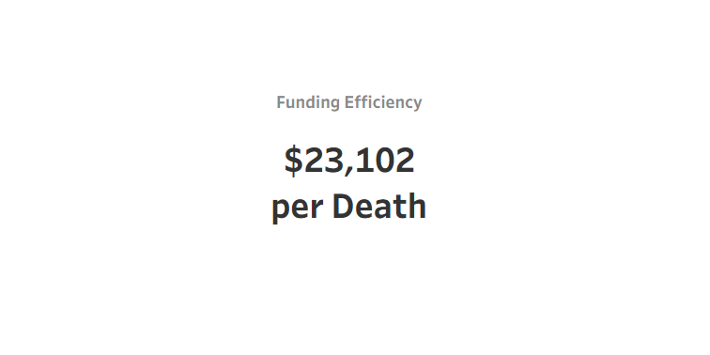


Key Metrics & Performance Indicator
Key Metric Developed: Funding Efficiency
• Defined as: 👉 Funding per Death
• Formula: 👉 Total Funding / Total Mortality
• Purpose: → Measures how efficiently funding is allocated relative to disease impact
• Why it matters: → Helps identify imbalance in resource allocation → Highlights diseases receiving disproportionate funding
👉 “Higher value indicates more funding per death, suggesting potential over-allocation.”

Slide 6
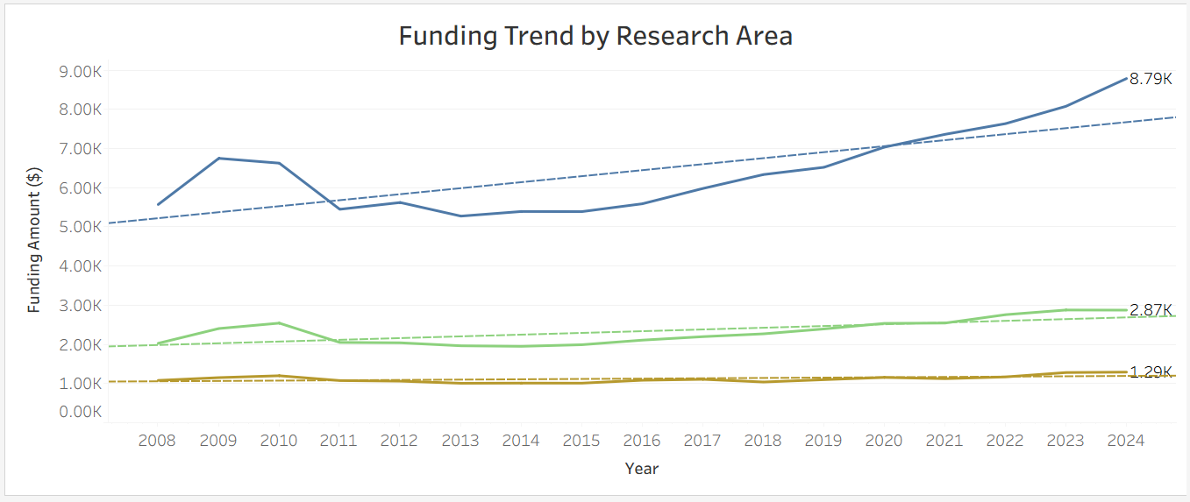
Mortality Trends Across Disease Areas
📈
⚠
Key Observations:
• Cardiovascular diseases consistently show the highest mortality • Cancer remains the second leading cause of death • Other diseases show relatively lower but steady trends • Mortality trends remain largely stable after 2011
“Cardiovascular and cancer dominate mortality, indicating high-impact disease areas requiring focused funding.”
🏥

Slide 7
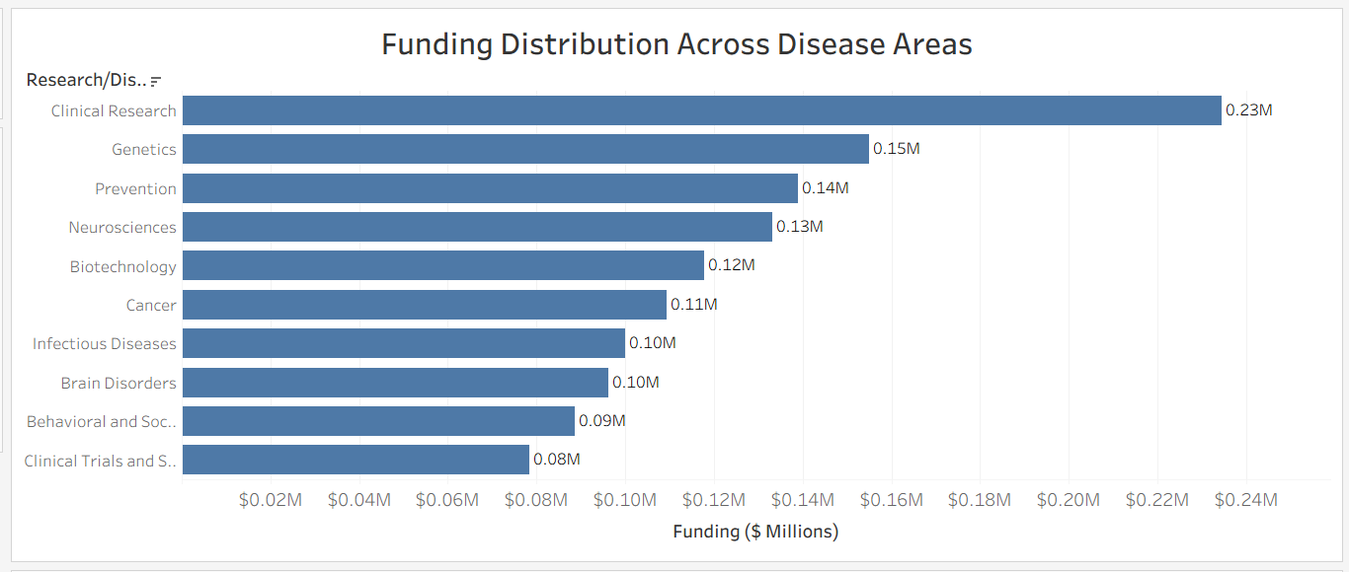
Funding Distribution Across Disease Areas
📊
Key Observations:
• Cancer receives the highest funding among all disease areas • Cardiovascular diseases receive substantial but comparatively lower funding • Some diseases with lower mortality still receive notable funding • Funding distribution does not perfectly align with mortality impact
“Funding allocation shows partial misalignment with disease impact, indicating potential inefficiencies.”
💵

Slide 8
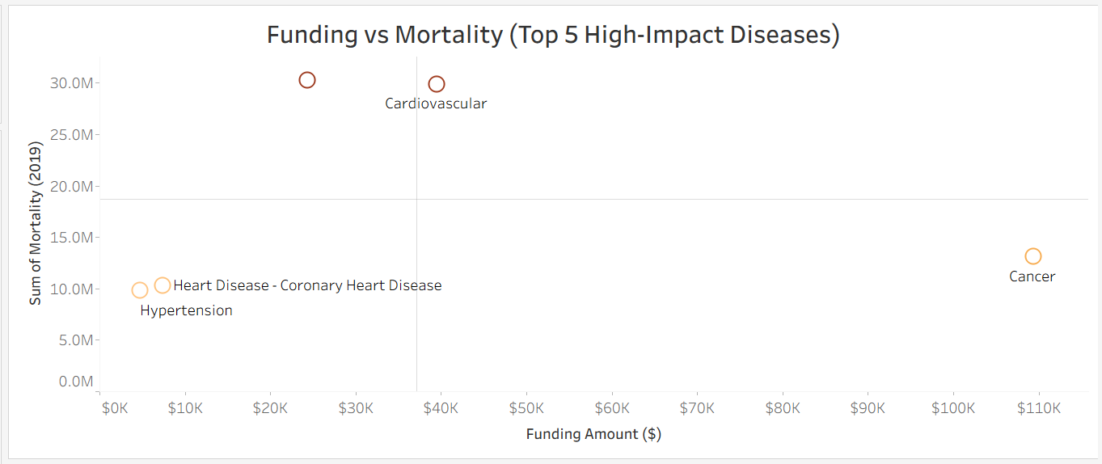
Identifying Underfunded High-Risk Diseases
⚠
Key Findings:
• Some diseases show high mortality but comparatively lower funding • Cancer receives both high funding and high research attention • Cardiovascular diseases exhibit extremely high mortality levels • Certain disease areas may be underfunded relative to their impact
“The analysis reveals that funding allocation is not always proportional to disease burden.”
📉

Slide 9
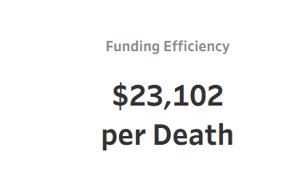
Funding Efficiency KPI Analysis
💰
Funding Efficiency measures the amount of healthcare funding allocated relative to disease mortality. The KPI is calculated using: Funding per Death = Total Funding / Total Mortality This metric helps evaluate whether healthcare investments are proportionate to disease impact.
Key Insight: The analysis shows an average funding efficiency of approximately $23,102 per death. Higher values indicate diseases receiving relatively higher funding compared to mortality impact, while lower values may indicate underfunded high-risk diseases.
🎯
Funding per Death = Funding Amount ($) ÷ Mortality (2019)

Slide 10
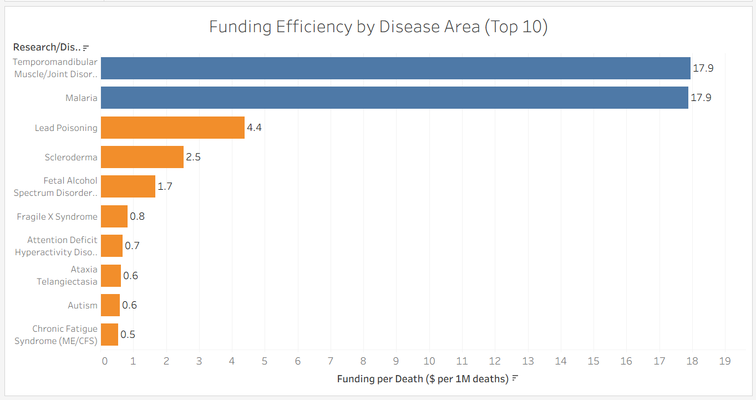
Top 10 Disease Areas by Funding Efficiency
📈
Comparing funding allocation efficiency across major disease areas
This visualization compares disease areas based on funding efficiency, calculated as funding allocated per mortality count.
Higher values indicate diseases receiving relatively greater funding compared to mortality impact, while lower values may highlight potentially underfunded areas.
Key Insights: • Temporomandibular Muscle/Joint Disorders and Malaria show the highest funding efficiency values. • Several diseases with lower funding efficiency may require further investigation for potential underfunding. • The analysis highlights imbalance in healthcare resource allocation across disease areas.
⚖
Blue → High Funding per Death Orange → Low Funding per Death

Slide 11

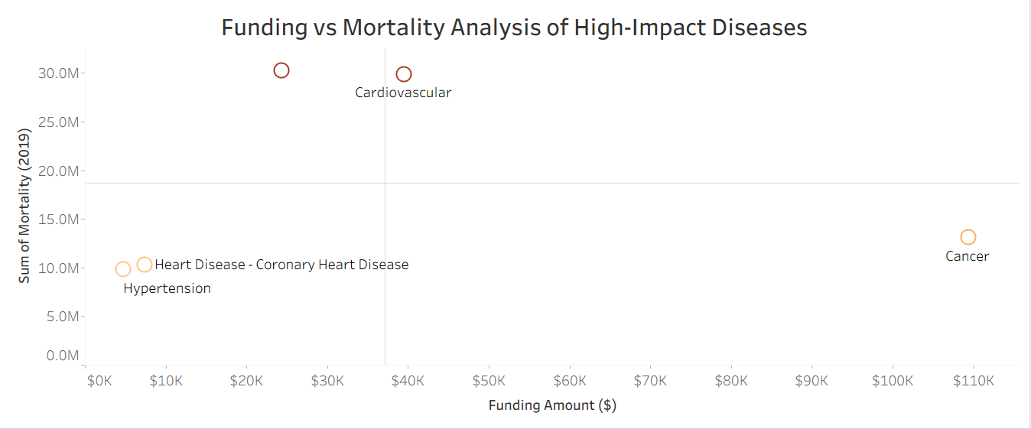
Identifying Underfunded High-Risk Diseases
This scatter plot compares healthcare funding against mortality levels across major disease areas. The reference lines divide the visualization into quadrants, helping identify diseases with: • High mortality but lower funding • High funding relative to mortality • Balanced funding allocation
Key Insights: • Cardiovascular diseases show extremely high mortality levels. • Cancer receives the highest funding allocation among major disease areas. • Some diseases demonstrate high mortality despite comparatively moderate funding levels, highlighting possible funding gaps.
📉
Top Left → High Mortality + Lower Funding Potentially underfunded high-risk diseases
Top Right → High Mortality + High Funding Major focus disease areas Bottom Right → Lower Mortality + High Funding Potentially overfunded areas
Bottom Left → Lower Mortality + Lower Funding Lower priority disease areas

Slide 12

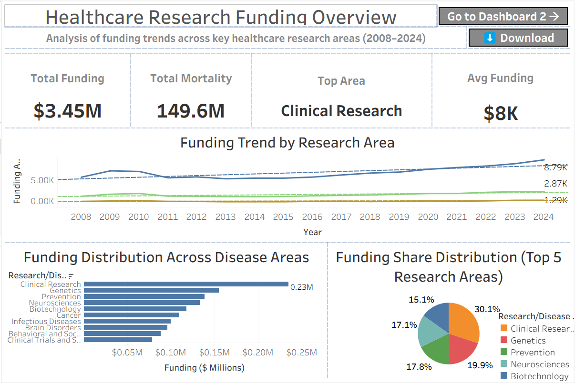

Healthcare Funding Overview Dashboard
Interactive Tableau Dashboard
This dashboard provides an executive-level overview of healthcare funding allocation, mortality trends, and disease impact analysis across major healthcare research areas.
Dashboard Features: • Interactive filters for disease analysis • Funding trend visualization • Mortality comparison metrics • KPI-driven healthcare insights • Executive-level healthcare analytics dashboard

Slide 13

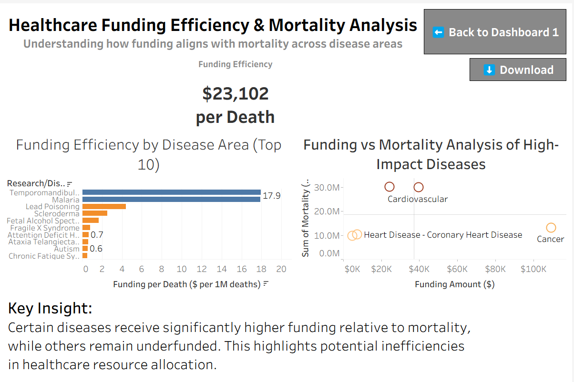
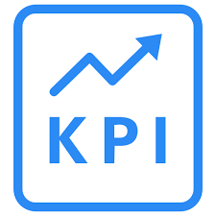
Funding Efficiency & Risk Analysis Dashboard
Evaluating funding allocation effectiveness across major disease areas
This dashboard focuses on evaluating healthcare funding efficiency by comparing funding allocation against mortality impact across disease areas. The dashboard combines KPI analysis, funding efficiency metrics, and mortality comparisons to identify potential funding imbalances.
Key Components: • Funding Efficiency KPI • Funding per Death analysis • Disease-wise funding efficiency comparison • Funding vs mortality scatter plot • Identification of underfunded high-risk diseases
Key Finding: Certain diseases exhibit disproportionately high mortality compared to funding allocation, indicating potential inefficiencies in healthcare resource distribution.

Slide 14

Key Insights & Business Findings
📌
Key Insights
Business Impact & Recommendations
Cardiovascular diseases showed extremely high mortality levels compared to several other disease areas.
Cancer research received the highest overall funding allocation among major healthcare research areas.
Certain diseases demonstrated disproportionately high mortality despite comparatively moderate funding levels.
Funding efficiency varied significantly across disease areas, indicating uneven resource distribution.
The analysis identified potential underfunded high-risk disease categories requiring deeper investigation.
Healthcare funding strategies should incorporate mortality impact metrics for more balanced resource allocation.
Data-driven dashboards improve visibility into funding efficiency and healthcare priorities.
Funding imbalance detection can support better long-term healthcare policy planning.
Continuous monitoring of funding versus mortality trends enables proactive decision-making.
Final Observation:
The analysis demonstrates that healthcare funding allocation is not always directly proportional to disease mortality impact, highlighting opportunities for more optimized resource distribution.

Slide 15
Project Challenges & Data Limitations
Practical challenges encountered during healthcare analytics implementation
⚠
✅
Challenges
Approach & Solutions
The dataset contained multiple year-wise funding columns requiring restructuring and preparation before analysis.
Funding values and mortality metrics required formatting adjustments for readable visualization and KPI creation.
Creating meaningful funding efficiency metrics required experimentation with calculated fields and normalization logic.
Balancing visual clarity, dashboard interactivity, and business storytelling was a key design challenge.
Interpreting funding imbalance patterns required careful comparison between funding allocation and mortality impact.
Applied data cleaning and restructuring techniques to organize year-wise funding data effectively.
Used Tableau calculated fields and formatting options to create standardized funding efficiency metrics.
Designed interactive dashboards with simplified layouts for better executive-level readability.
Implemented comparative visualizations such as scatter plots and KPI indicators to improve insight generation.
🎓
Key Learning: The project strengthened practical skills in data cleaning, KPI development, dashboard storytelling, and analytical decision-making using Tableau.

Slide 16
Tools & Technologies Used
📊 Tableau Interactive dashboards, calculated fields, KPIs, and visual analytics.
📂 Microsoft Excel Dataset preparation, data review, and initial data structuring.
📈 Data Visualization Line charts, scatter plots, bar charts, KPI cards, and pie charts.
💰 KPI Development Custom funding efficiency metrics using calculated fields.
🎨 Dashboard Design Executive-style storytelling with interactive healthcare dashboards.
Technologies and analytical techniques used throughout the project

Slide 17
Business Recommendations & Strategic Actions
Data-Driven Funding Allocation
Healthcare funding decisions should incorporate mortality and disease impact metrics for balanced resource allocation.
Continuous Performance Monitoring
Regular monitoring of funding efficiency KPIs can help identify emerging underfunded high-risk disease areas.
🎯
📊
Executive Dashboard Adoption
Interactive healthcare dashboards can improve strategic decision-making and transparency in funding analysis.
Future Predictive Analytics
Future healthcare analytics initiatives can incorporate predictive modeling to forecast mortality and funding requirements.
🤖
💡
Strategic Conclusion:
Data-driven healthcare funding strategies can improve funding efficiency, reduce allocation imbalances, and support better healthcare outcomes.

Slide 18
Future Scope & Enhancements
🌐
Real-Time Healthcare Data Future dashboards can integrate live healthcare funding and mortality datasets for real-time monitoring.
Predictive Healthcare Modeling Machine learning models can forecast disease trends, mortality rates, and future funding requirements.
🤖
🗺
Geographic Healthcare Insights
Regional healthcare funding analysis can identify geographic disparities in healthcare resource allocation.
Advanced KPI Monitoring
Additional KPIs such as survival rates, treatment efficiency, and patient outcomes can enhance analysis depth.
📊
AI-Based Healthcare Decision Support
AI-powered analytics can support policymakers in optimizing healthcare funding strategies dynamically.
🧠
💡
Future Vision:
Healthcare analytics platforms can evolve into intelligent decision-support systems enabling proactive and data-driven healthcare planning.

Slide 19
Project Outcome & Business Value
Key outcomes achieved through healthcare funding analytics and visualization
Improved Healthcare Insights
The project successfully identified funding allocation trends and mortality-based healthcare impact patterns.
💡
Funding Efficiency KPI
Custom funding efficiency metrics enabled better comparison between healthcare funding and disease mortality.
💰
Interactive Dashboard Reporting
Executive-style dashboards transformed complex healthcare datasets into understandable visual insights.
🎯
🖥
Strategic Decision Support
The analysis supports more informed healthcare funding decisions through data-driven visualization.
🚀
Project Impact:
The healthcare funding efficiency analysis demonstrated how data visualization and KPI-driven analytics can support better healthcare planning and resource optimization.

Slide 20
Final Conclusions from Healthcare Funding Analysis
Key conclusions derived from healthcare funding and mortality analysis
Healthcare funding distribution varies significantly across disease areas. ⚖
Funding efficiency analysis revealed potential imbalances between healthcare investment and mortality
impact.
Interactive dashboards improved understanding of funding trends, mortality patterns, and healthcare priorities.
Data-driven healthcare analytics can support more strategic and optimized funding decisions.
💰
⚖
🖥
🎯
Final Takeaway:
The project demonstrates how Tableau dashboards and KPI-driven analytics can transform healthcare data into actionable business insights for smarter healthcare planning.
💡

Slide 21
Thank You!
Healthcare Funding Efficiency Analysis
Presented by:
Bhagyalaxmi Nair 📊
🙏

